Slide 1
Working at Height from Ladders & Steps
A Toolbox Talk
covering the use of Ladders, Steps and associated Work at Height Equipment
TB Davies Lewis Road, Cardiff CF24 5EB T: 029 2132 0000 https://www.tbdavies.co.uk

Slide 2
Introduction
Falls from height are a leading cause of serious and fatal injuries in the workplace.
The goals of this talk are to help you:
manage risk by educating your team on how to select and use the most appropriate piece of equipment when working at height
understand how to anticipate the risks of fall hazards in your work place
understand the Health & Safety Executives short duration and low level safety requirements when working at height

Slide 3
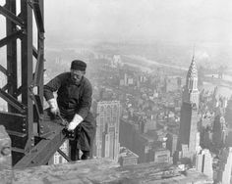
What is Work at Height?
Work at Height means work in any place where, if there were no precautions in place, a person could fall a distance liable to cause personal injury.
Take a sensible approach to working at height. There may be some low-risk situations where common sense tells you no particular precautions are necessary, the law recognizes this.

Slide 4
The percentage of fatal injuries due to falls from height has not decreased
in 2013/14 thirty-nine fatal injuries to workers involved falls from height. Eighteen were in the building trades, six in farming and four in manufacturing. All fatal fall injuries were males
27% of major specified injuries (fractures, amputations etc.) involved falls from height with the highest fall injury rates to older men
Falls from height are not subject to seasonal variations
Source – HSE Slips & trips and falls from height in Great Britain, 2014 (Total 28, 528 reports, 6521 were falls from height – 39 fatal/3,317 major/ 3,165 over 7 days)

Slide 5
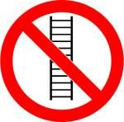
Are ladders & step ladders banned?
There is a common misconception that ladders and stepladders are banned, but this is not the case.
There are many situations where a ladder is the most suitable equipment for working at height. For tasks of low risk or short duration, ladders and step ladders can be a sensible option.
Remember - Take a sensible approach to working at height. There may be some low-risk situations where common sense tells you no particular precautions are necessary, the law recognizes this.
Source – HSE indg 344, 401, 455

Slide 6
Hierarchy of Fall Protection
Avoid Working at Height
Avoid working at height were possible using tools and plant from ground level.
Where there are no fixed parapets or guardrails consider a Freestanding Guardrail System or else other collective protection plant such as MEWPS, Scaffold, Towers, or at lower heights Podiums.
Guard the Hazard
Protect the Worker
If the risk of a fall remains minimise the distance or consequence of the fall with a suitable Fall Protection System.
Low Risk Short Duration Work
For tasks of low risk or short duration, ladders and step ladders can be a sensible option.
MEWPS – Mobile Elevated Work Platforms (Eg Scissor Lifts)

Slide 7
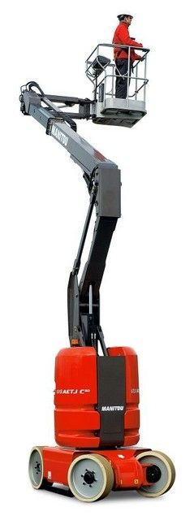
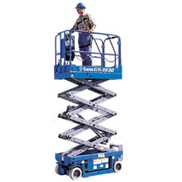
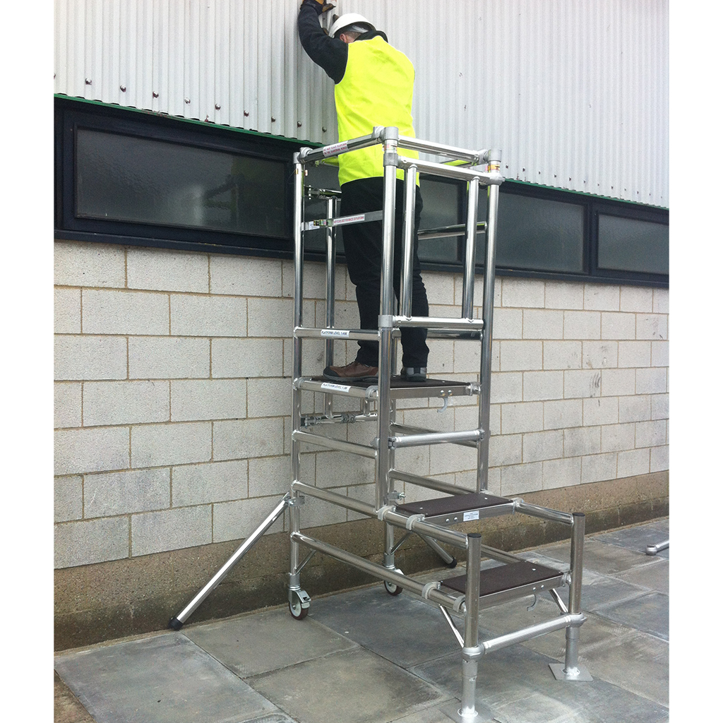
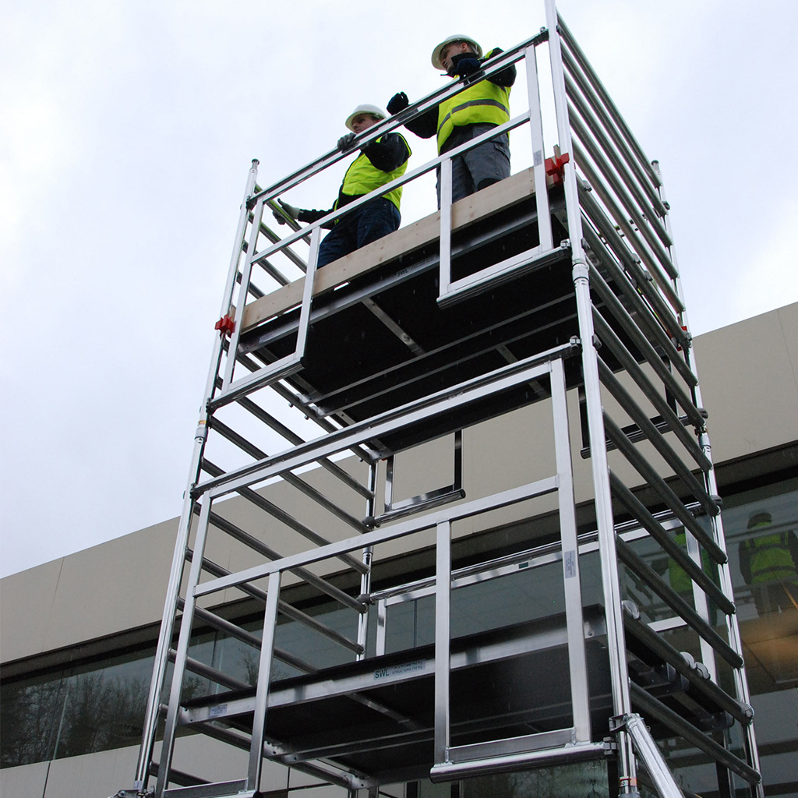
Examples of temporary products that help us ‘Guard the Hazard’
Freestanding Guardrail Systems
KeeGuard
VersiRail
Mobile Elevated Work Platforms
(MEWPS)
Genie Scissor
Manitou Articulated Boom
Mobile Scaffold Towers & Podiums
TB Davies Podium Step
TB Davies Contractor Tower

Slide 8
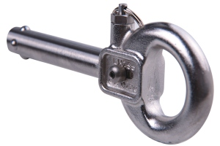
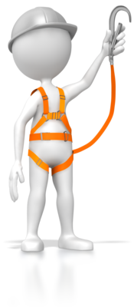
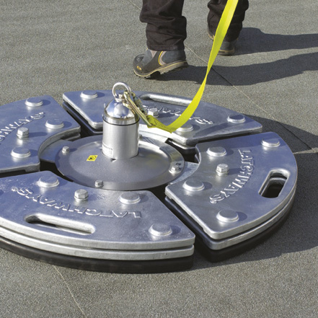
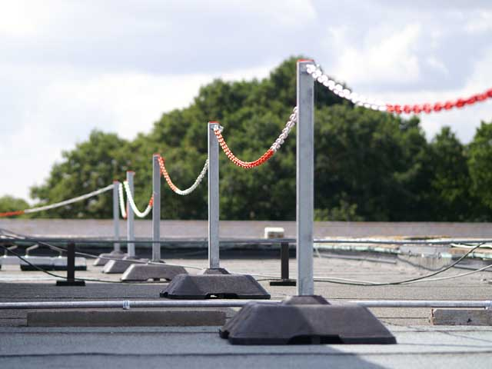
‘Protect the Worker’ Types of Fall Protection Systems
Personal Fall Arrest Systems
Class A – Fixed Anchor Points
Class B – Temporary Systems
Class C - Horizontal Lifelines
Safety Nets
Demarcation Systems (an economical solution to Freestanding Guardrail Systems providing it is placed at least 2m from the roof edge.)
Temporary Eyebolts
Freestanding Weighted Anchor to BS EN 795
Safesite Demarcation Systems

Slide 9
When is a ladder the most suitable equipment?
The law says that ladders can be used for work at height when a risk assessment has shown that using equipment offering a higher level of fall protection is not justified because of the low risk and short duration of use; or there are existing workplace features which cannot be altered.
Source – HSE indg 344, 401, 455

Slide 10
Is specialized training required to use ladders?
You should make sure that people with sufficient skills, knowledge and experience are employed to perform the task, or, if they are being trained, that they work under the supervision of somebody competent to do it. Training often takes place on the job, it does not always take place in a classroom.
In the case of low-risk, short duration tasks (short duration means tasks that take less than 30 minutes) involving ladders, competence requirements may be no more than making sure employees receive instruction on how to use the equipment safely (eg how to tie a ladder properly) and appropriate training.
When a more technical level of competence is required, existing training and certification schemes drawn up by the Ladder Association is one way to help demonstrate competence.
Source – HSE indg 344, 401, 455

Slide 11
What is Short Duration Work?
As a guide, if your task would require staying up a leaning ladder or stepladder for more than 30 minutes at a time, it is recommended that you consider alternative equipment.
Source – HSE indg 344, 401, 455

Slide 12
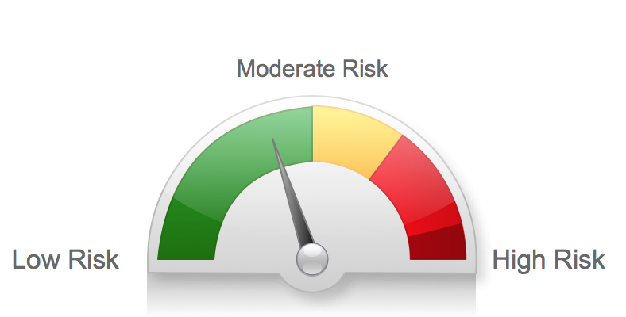
What is Low Risk?
The guidance from the HSE leaves this to your judgment but do allude to examples such as ‘Starting a Screw’, ‘Hanging Wallpaper’, ‘Installing a Smoke Detector’ etc.
Using these examples should provide an idea of what you may define as Low risk.
Source – HSE indg 344, 401, 455

Slide 13
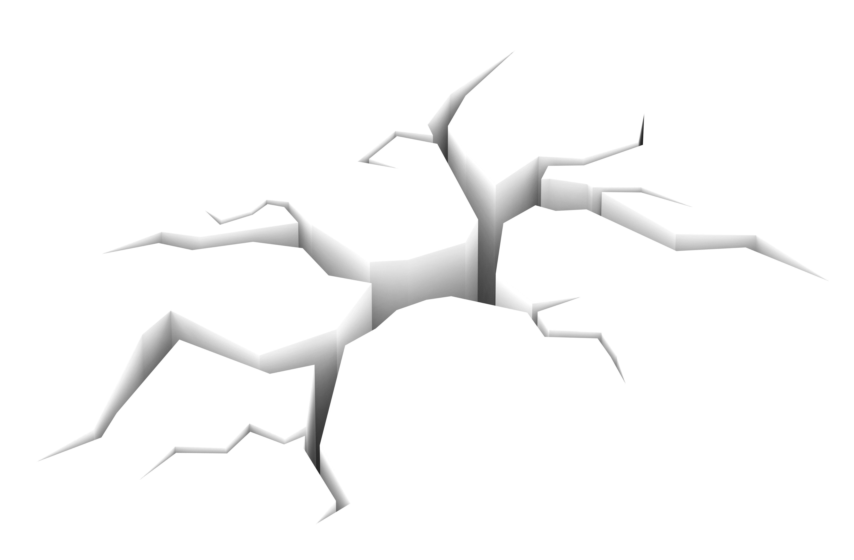
You should only use ladders and steps in situations where they can be used safely.
Ladders and steps needs to be
Level
Stable
Ladders need to be secured (where it is reasonably practicable to do so).
You can source ladders or accessories that can help make your ladder meet these requirements
Check all four stepladder feet are in contact with the ground and the steps are level
Source – HSE indg 344, 401, 455

Slide 14
Pre Use Checks
At the beginning of the working day the user should make the following checks or after something has changed (eg a ladder has been dropped or moved from a dirty area to a clean area).
Check the stiles – make sure they are not bent or damaged
Check the feet – if they are missing, worn, damaged or dirty (eg soil, chippings or embedded stones) the ladder could slip.
Check the rungs – if they are bent, worn, missing or loose the ladder could fail.
Check any locking mechanisms – if they are bent or the fixings are worn or damaged the ladder could collapse. Ensure any locking bars are engaged.
Check the stepladder platform – if it is split or buckled the ladder could become unstable or collapse.
Check the steps or treads on stepladders – if they are contaminated they could be slippery; if the fixings are loose on steps, they could collapse.

Slide 15
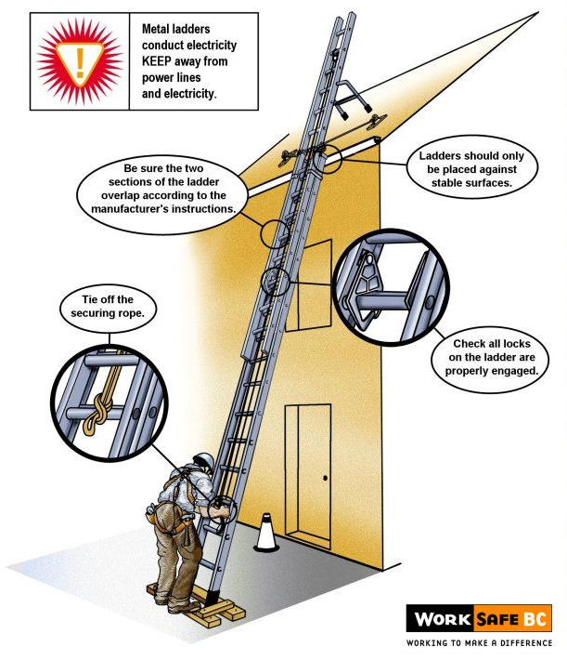
Leaning Ladders Setting up.
Don’t overload it – consider workers’ weight, equipment & materials
Don’t try to move or extend ladders while standing on the rungs
Don’t work off the top three rungs
Don’t stand ladders on moveable objects
Don’t work within 6 m horizontally of any overhead power line
Source – HSE indg 344, 401, 455 / Image courtesy of WorkSafeBC Canada

Slide 16
Leaning Ladders Setting up
Make sure the ladder angle is at 75°
Tie the ladder to a suitable point, making sure both stiles are tied
Where this is not practical, secure with an effective ladder stability device, ‘footing’ is the last resort.
Source – HSE indg 344, 401, 455 / Image courtesy of WorkSafeBC Canada

Slide 17
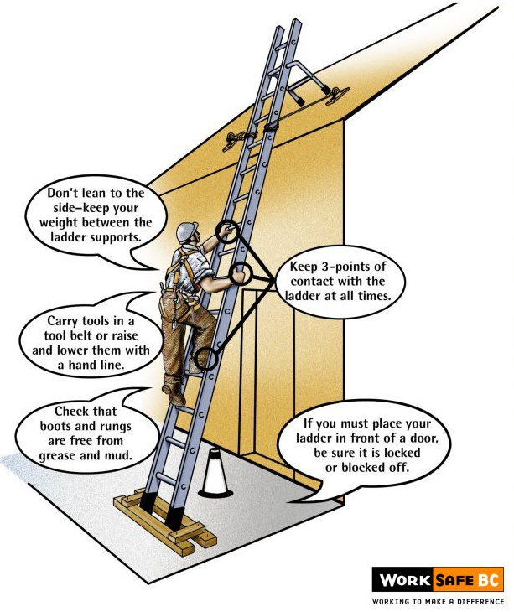
Leaning Ladders Climbing
Always grip the ladder and face the ladder rungs while climbing or descending
Avoid holding items when climbing (consider using a tool belt)
Maintain three points of contact when climbing (this means a hand and two feet)
Do not rest a ladder against weak upper surfaces (eg glazing or plastic gutters)
Source – HSE indg 344, 401, 455 / Image courtesy of WorkSafeBC Canada

Slide 18
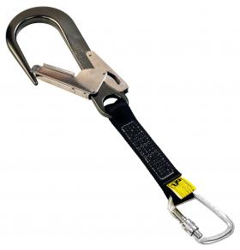
Three points of contact other than a brief period.
Maintain three points of contact wherever possible at the work position.
Where you cannot maintain a handhold, other than for a brief period (e.g. to hold a nail while starting to knock it in, starting a screw etc.), you will need to take other measures to prevent a fall or reduce the consequences if one happened.
A work positioning belt with a short lanyard may be appropriate if the ladder is suitably secured.
Working through the ladder with your body resting against may help in preventing a fall.
Source – HSE indg 344, 401, 455

Slide 19
Ladder stability solutions
Ladder stability is a major root cause in accidents involving ladders. Research on leaning ladders has shown that base slip and movement at the top of the ladder are the top cause for accidents.
TB Davies Pinnacle Combination ladders have built in levelling and stability to reduce the chance of the ladder moving at the base or the top.
Latest generation Little Giant Ladders have in built stabiliser and leg levelling options.
Splayed bases reduce the chance of the ladder moving as standard.
Source – HSE/GPSD ‘2009 Safety of Ladders report’

Slide 20
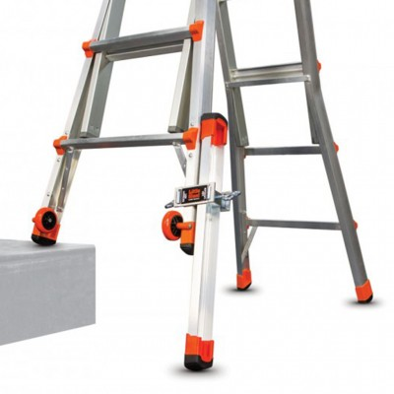
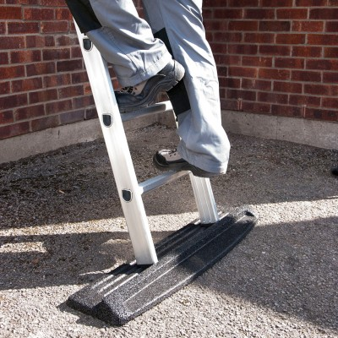
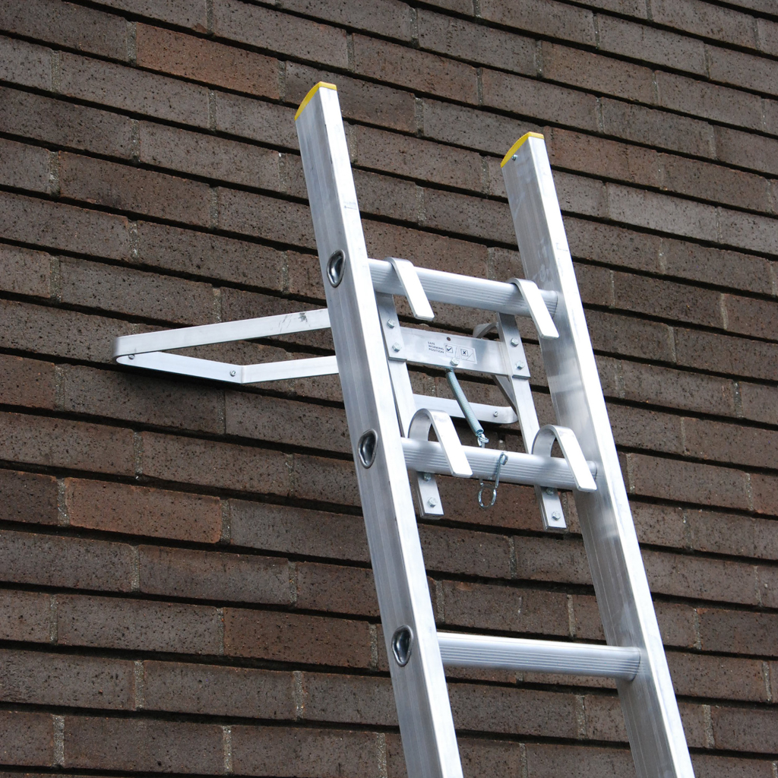
Ladder safety accessories
Ladder stability is a major root cause in accidents involving ladders. Research on leaning ladders has shown that base slip and movement at the top of the ladder are the top cause for accidents.
Little Giant Ladders have leg levelling accessories to cope with uneven ground, slopes or steps.
TB Davies Ladder Base reduces the risk of slip on a range of surfaces.
TB Davies Stand Off bracket ensures the ladder is secured against a stable surface.
Source – HSE/GPSD ‘2009 Safety of Ladders report’

Slide 21
What about ladders used for access?
Ladders used to access another level should be tied and extend at least 1 m (typically three clear rungs) above the landing point to provide a secure handhold. At ladder access points, a self-closing gate is recommended
Stepladders should not be used to access another level, unless they have been specifically designed for this.
Source – HSE indg 344, 401, 455

Slide 22
Step Ladders
When deciding if it is safe to carry out a particular task on a stepladder where you cannot maintain a handhold (eg to put a box on a shelf, hang wallpaper, install a smoke detector on a ceiling), this needs to be justified, taking into account:
The height of the task
Whether a handhold is still available to steady yourself before and after the task
Whether it is light work
Whether it avoids side loading
Whether it avoids overreaching
Whether the stepladder can be tied (e.g. when side-on working)
Source – HSE indg 344, 401, 455

Slide 23
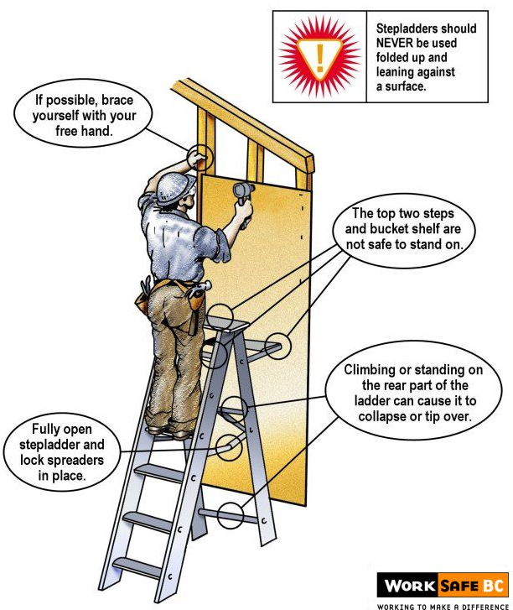
Step Ladders Positioning and working ‘Side on’
A study by the HSE has shown sideways tipping accounts for 40% of stepladder accidents.
However, there are occasions when a risk assessment may show it is safer to work side on, eg in a retail stock room when you can’t engage the stepladder locks to work face on because of space restraints in narrow aisles, but you can fully lock it to work side on.
Try to avoid work that imposes a side loading, such as side-on drilling through solid materials (e.g. bricks or concrete)
Where side-on loadings cannot be avoided, you should prevent the steps from tipping over. If you cannot secure the step you need to consider using a more suitable type of access equipment such as a podium step.
3
Try to position the stepladder to face the work activity and not side on.
Source – HSE/GPSD ‘2009 Safety of Ladders report’ / HSE indg 344, 401, 455 /

Slide 24
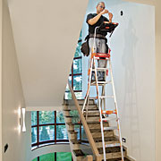
Step Ladder Stability
Check all four stepladder feet are in contact with the ground and the steps are level. Some step ladders may have stability solutions built in to help adjust the step on uneven ground surfaces
Only carry light materials and tools and consider a tool belt or a steps with a built in work tray.
Don’t overreach
Little Giant Select Steps can work on stairs and adjust to different heights reducing the risk of overreaching.
Source – HSE/GPSD ‘2009 Safety of Ladders report’ / HSE indg 344, 401, 455

Slide 25
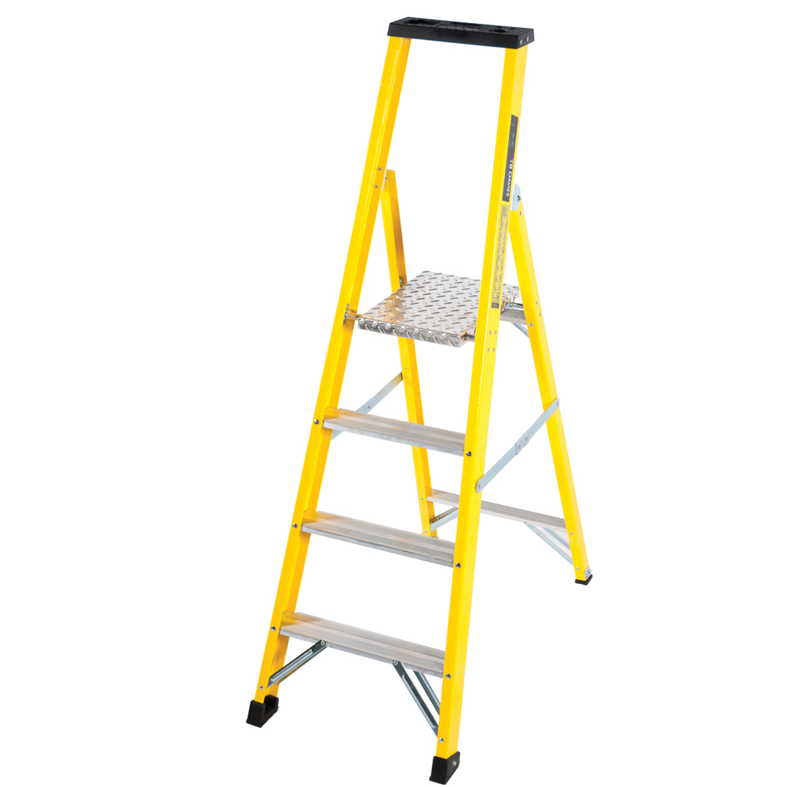
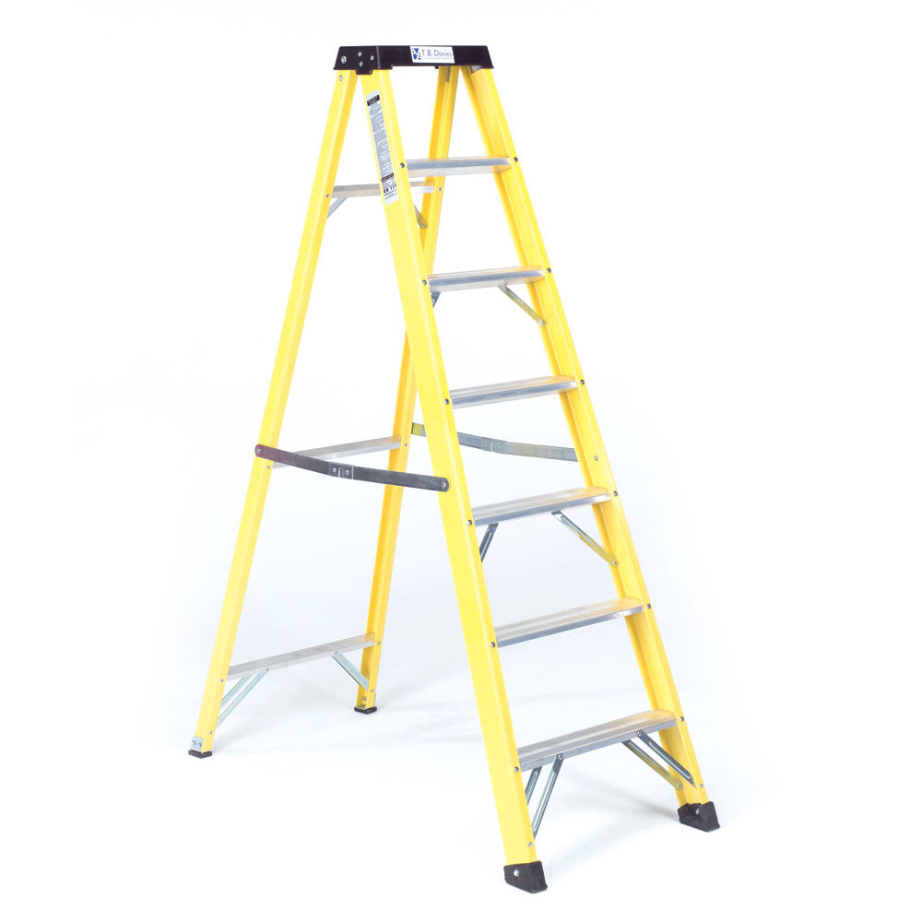
Can I stand on the Platform of a Platform Step?
Don’t stand and work on the top three steps (including a step forming the very top of the stepladder) unless there is a suitable handhold.
The red line indicates this is the highest tread you can work from on a Swingback or Builders type step.
Here you can stand on the platform as the parapet or continuous handrail provides a suitable handhold and third point of contact.
Source – HSE indg 344, 401, 455 /

Slide 26
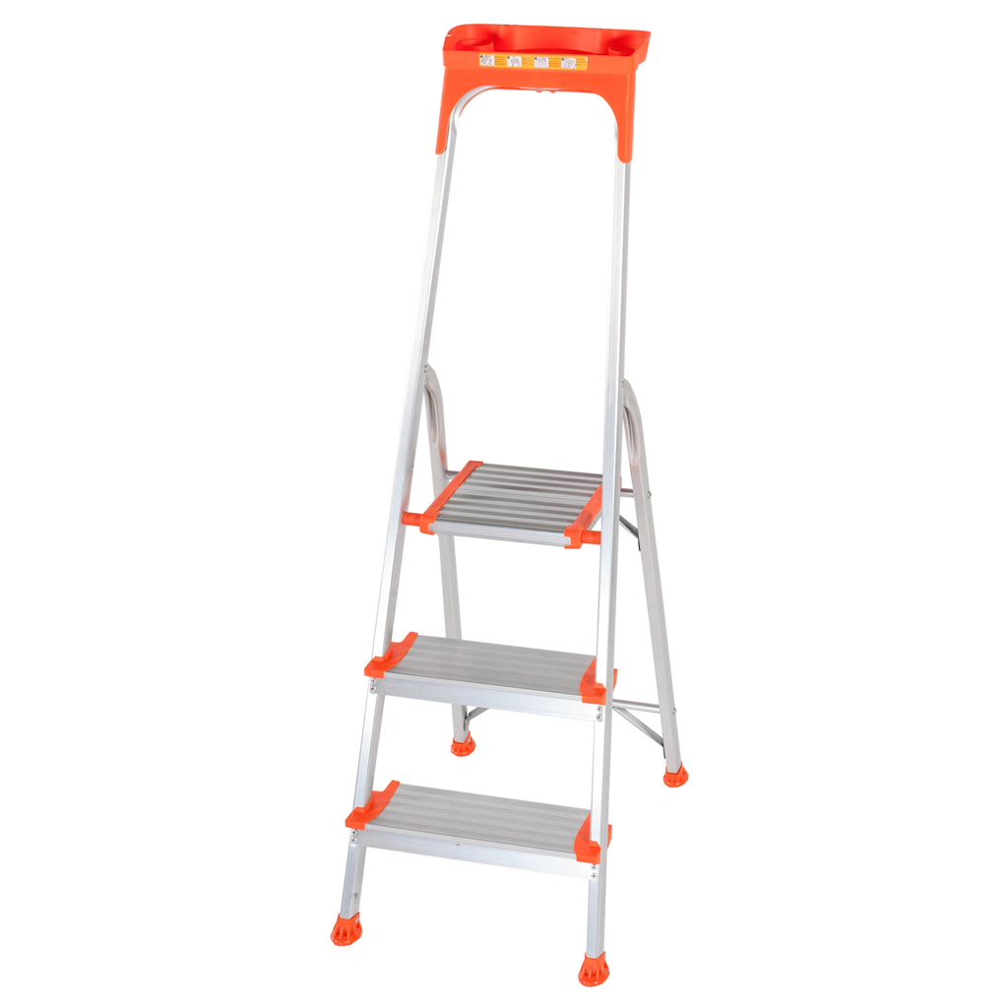
You can use both hands for brief periods on a step ladder!
Maintain three points of contact at the working position. This means two feet and one hand, or when both hands need to be free for a brief period, two feet and the body supported by the stepladder.
Where two hands need to be free for a brief period for light work. Keep two feet on the same step and the body (knees or chest) supported by the stepladder to maintain three points of contact.
Make sure a safe handhold is available.
Knee Bar or continuous Handrail provides a third point of contact for the Knee or Thigh area and a safe handhold as required.
Large working platform shows space for both feet
Source – HSE indg 344, 401, 455

Slide 27
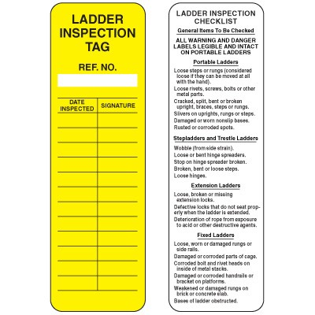
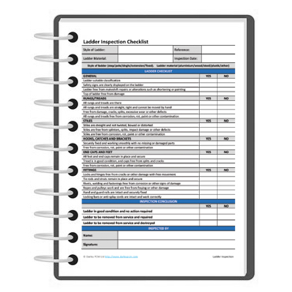
Keeping records
You are required to keep a record of any inspection for types of work equipment including: guard rails, toe-boards, barriers or similar collective means of protection; working platforms (any platform used as a place of work or as a means of getting to and from work, e.g. a gangway) that are fixed (e.g. a scaffold around a building) or mobile (e.g. a mobile elevated working platform (MEWP) or scaffold tower); or a ladder.
Source – HSE indg 344, 401, 455

Slide 28
Users responsibilities
Employees have general legal duties to take reasonable care of themselves and others who may be affected by their actions, and to co-operate with their employer to enable their health and safety duties and requirements to be complied with.
For an employee, or those working under someone else’s control, the law says they must:
Report any safety hazard they identify to their employer;
Use the equipment and safety devices supplied or given to them properly, in accordance with any training and instructions (unless they think that would be unsafe, in which case they should seek further instructions before continuing).
Source – HSE indg 344, 401, 455

Slide 29
Employers responsibilities
Employers need to make sure that any ladder or stepladder is both suitable for the work task and in a safe condition before use. As a guide, only use ladders or stepladders that:
Have no visible defects. They should have a pre-use check each working day
Have an up-to-date record of the detailed visual inspections carried out regularly by a competent person. These should be done in accordance with the manufacturer’s instructions
Are suitable for the intended use, ie are strong and robust enough for the job
Source – HSE indg 344, 401, 455

Slide 30
Thank You for attending this Toolbox talk. We hope you found it informative and will help you select the most appropriate equipment and work more safely when using ladders.
Disclaimer
While every care has been taken in compiling the information contained in this document, we do not make any representations as to the completeness, accuracy or up-to-date nature of such information. We do not accept any liability for any loss or damage arising directly or indirectly from reliance on any of the contents of this information.
TB Davies Lewis Road, Cardiff CF24 5EB T: 029 2132 0000 https://www.tbdavies.co.uk

